Slide 1
YELAHANKA ECO GROUP (YEG)
WHO ARE WE?
YEG includes Civil Defence Team, Friends of Lakes, Civic Warriors and Namma Vidyaranyapura, some schools and temple authorities and an NGO. And, of course, the BBMP staff.
We have taken up waste management as a major responsibility along with lake rejuvenation and other environmental causes.

Slide 2
FESTIVAL WASTE MANAGMENT
An unprecedented co-ordinated effort by BBMP officials and committed YEG volunteers that cleaned up the festival waste overnight on the last four major FESTIVALS—GANESHA, BAKRID, DASARA and DEEPAVALI.

Slide 3
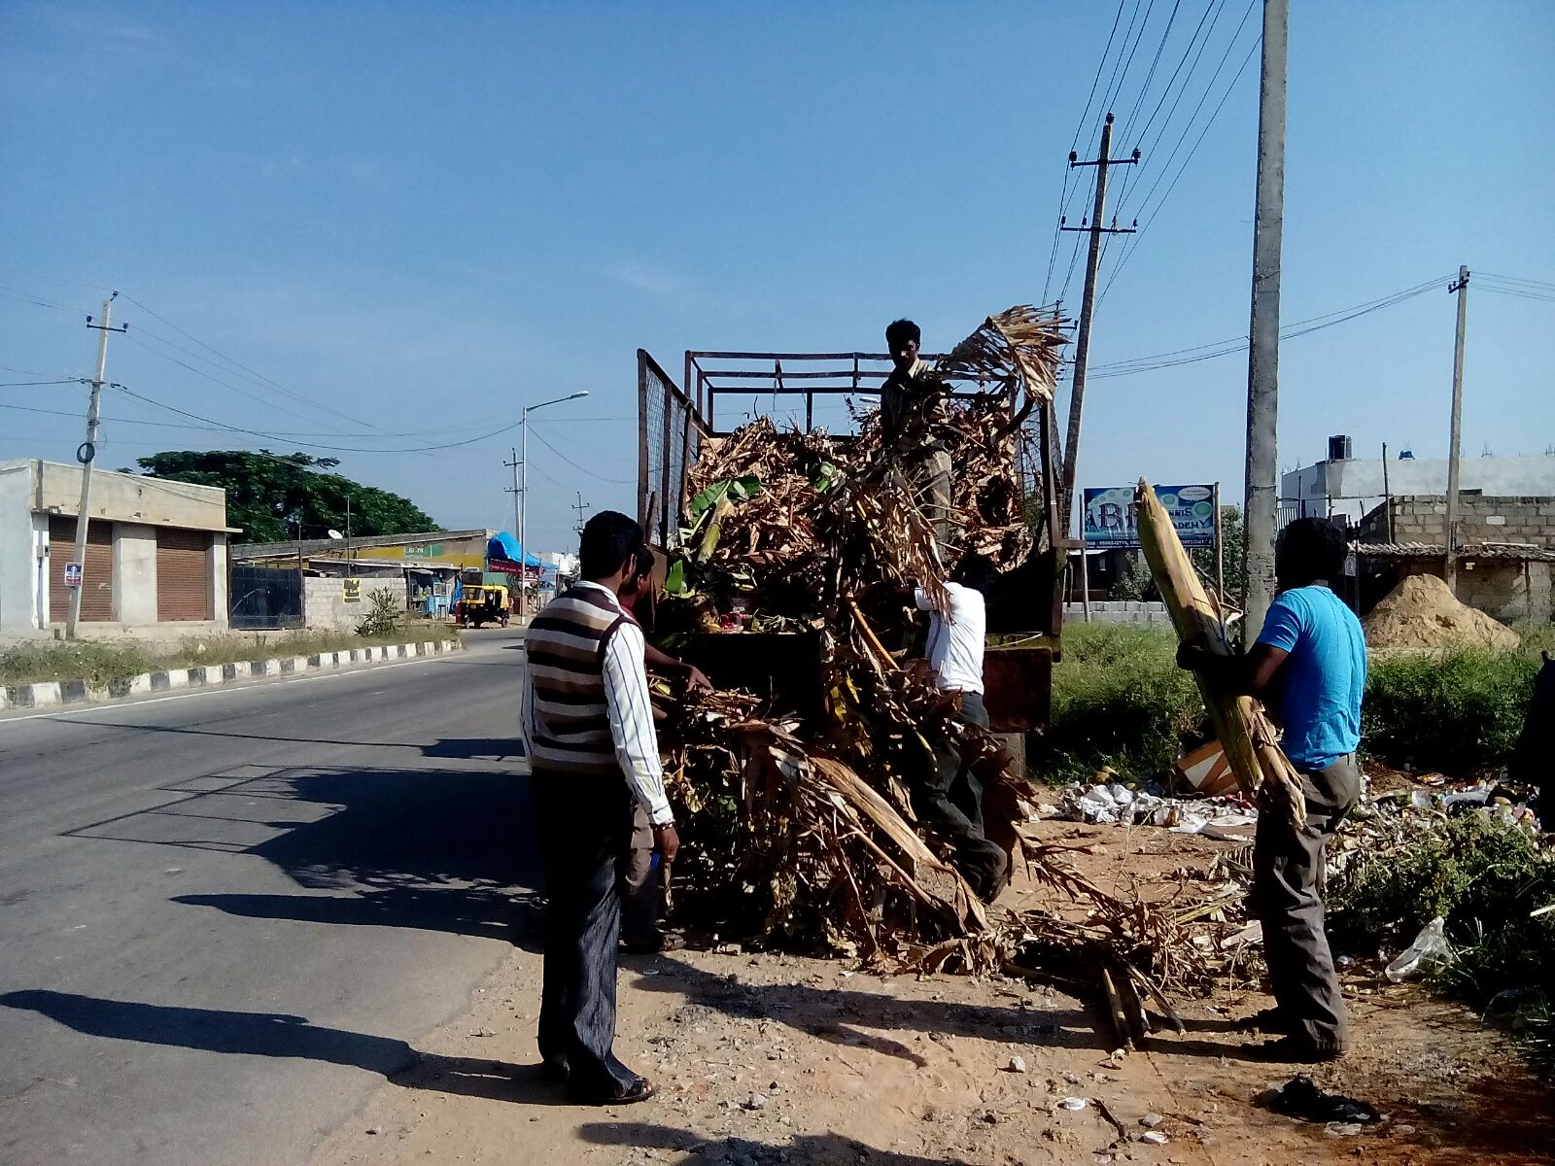

Slide 4
GANESHA FESTIVAL
Friends of Lakes stalled idol immersion in eight lakes of Yelahanka.
They erected makeshift Kalyanis and allowed immersion only in these trenches layered with plastic near each lake.
They segregated all the green waste and composted it on the spot.

Slide 5
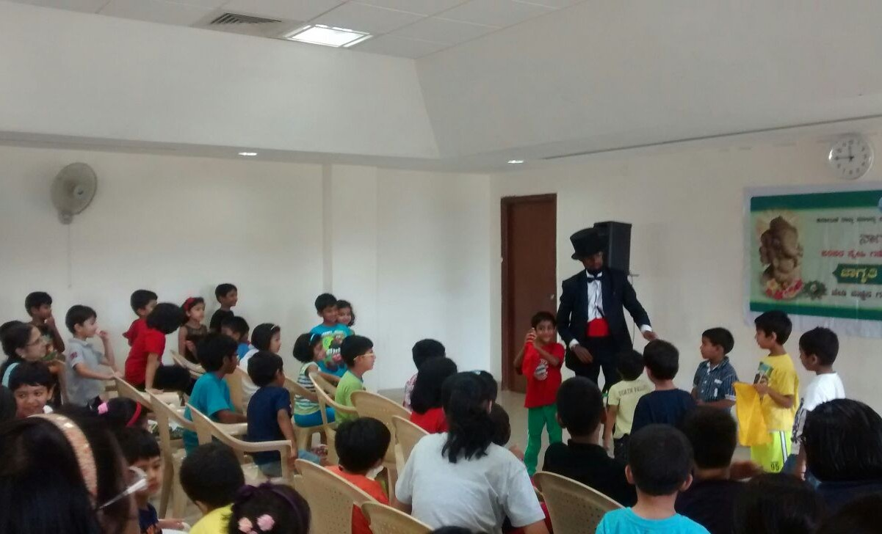
An awareness programme highlighting the dangers posed by PoP idols in progress in a Yelahanka school.

Slide 6
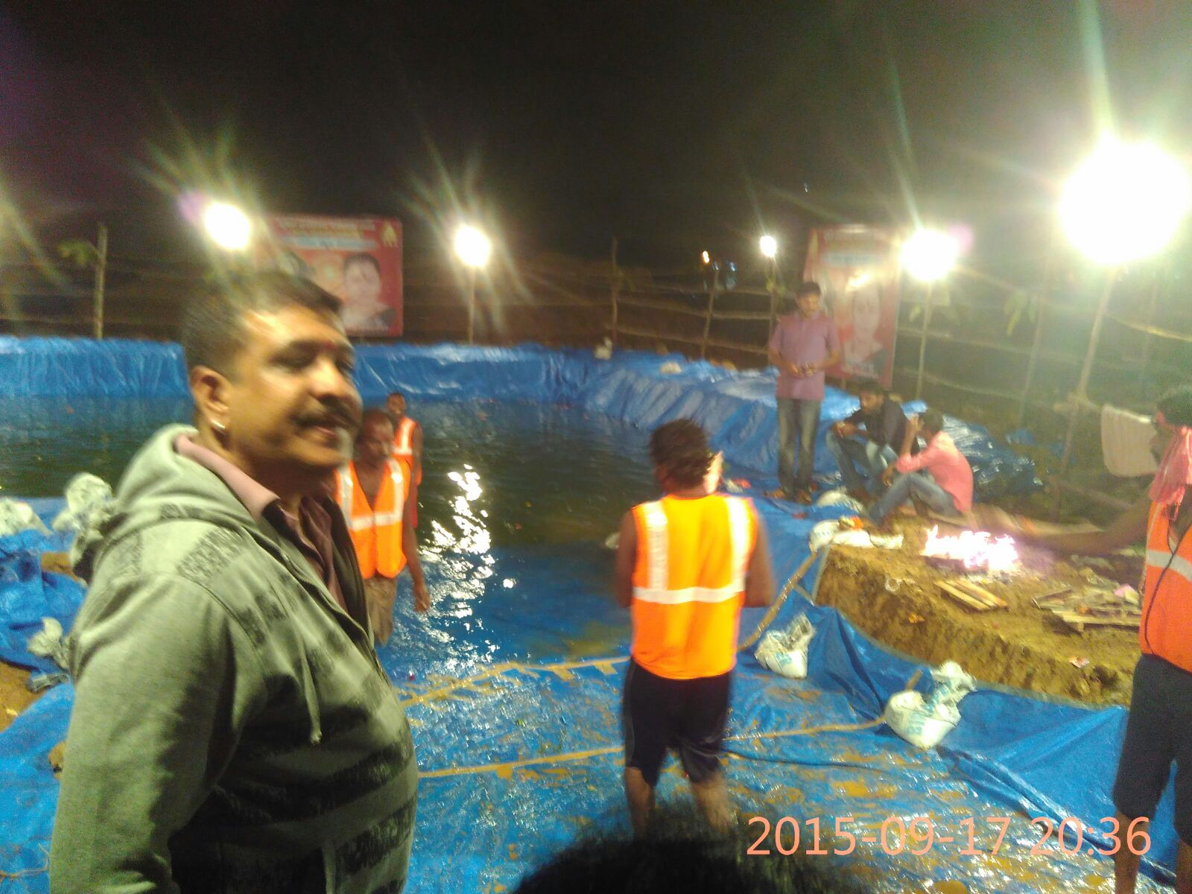
A makeshift Kalyani erected near a lake for idol immersion.

Slide 7
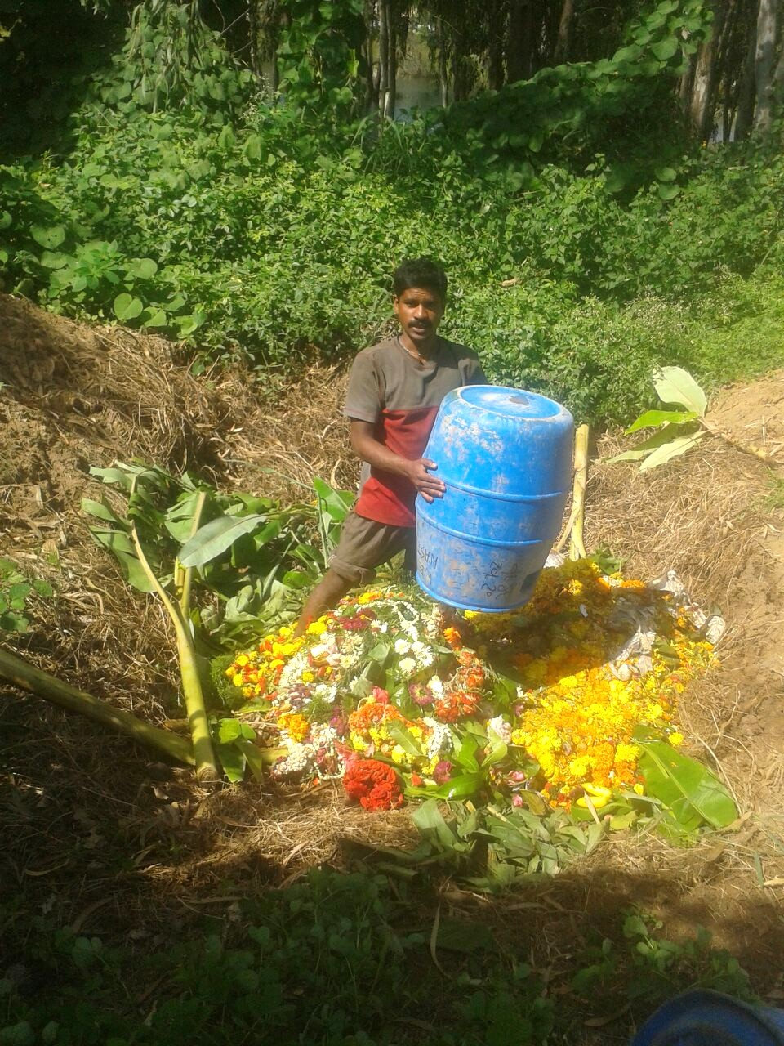
Composting of Ganesha festival near a lake in Yelahanka. It tells us clearly the value of segregated waste.

Slide 8
OVERCOMING DIFFICULTIES
PoP idols made the job of volunteers a lot more difficult as they are non-biodegradable and had to be transported to far-off quarries for dumping.
People dumped large king-size idols dumped near the Kalyani and went home.

Slide 9
BAKRID FESTIVAL
Meat waste management
Joint Commissioner Sarfaraz Khan lead YEG from the front.
Intensified awareness programmes in all mosques and meat stalls stressing the importance of segregation.
Arrangements were made for safe transportation of the waste within three hours.

Slide 10
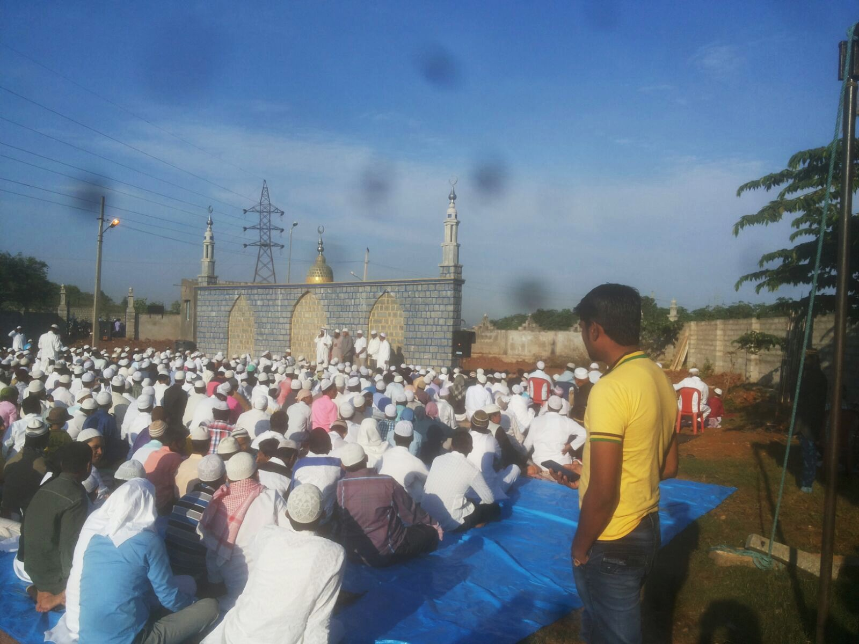

Slide 11
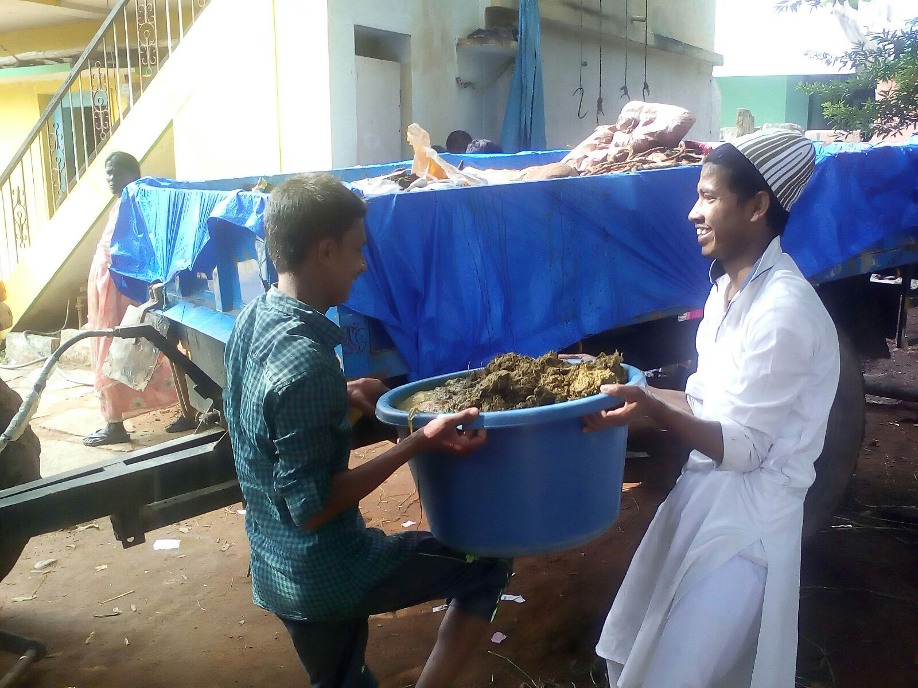
Segregated meat waste being loaded into a truck by volunteers.

Slide 12
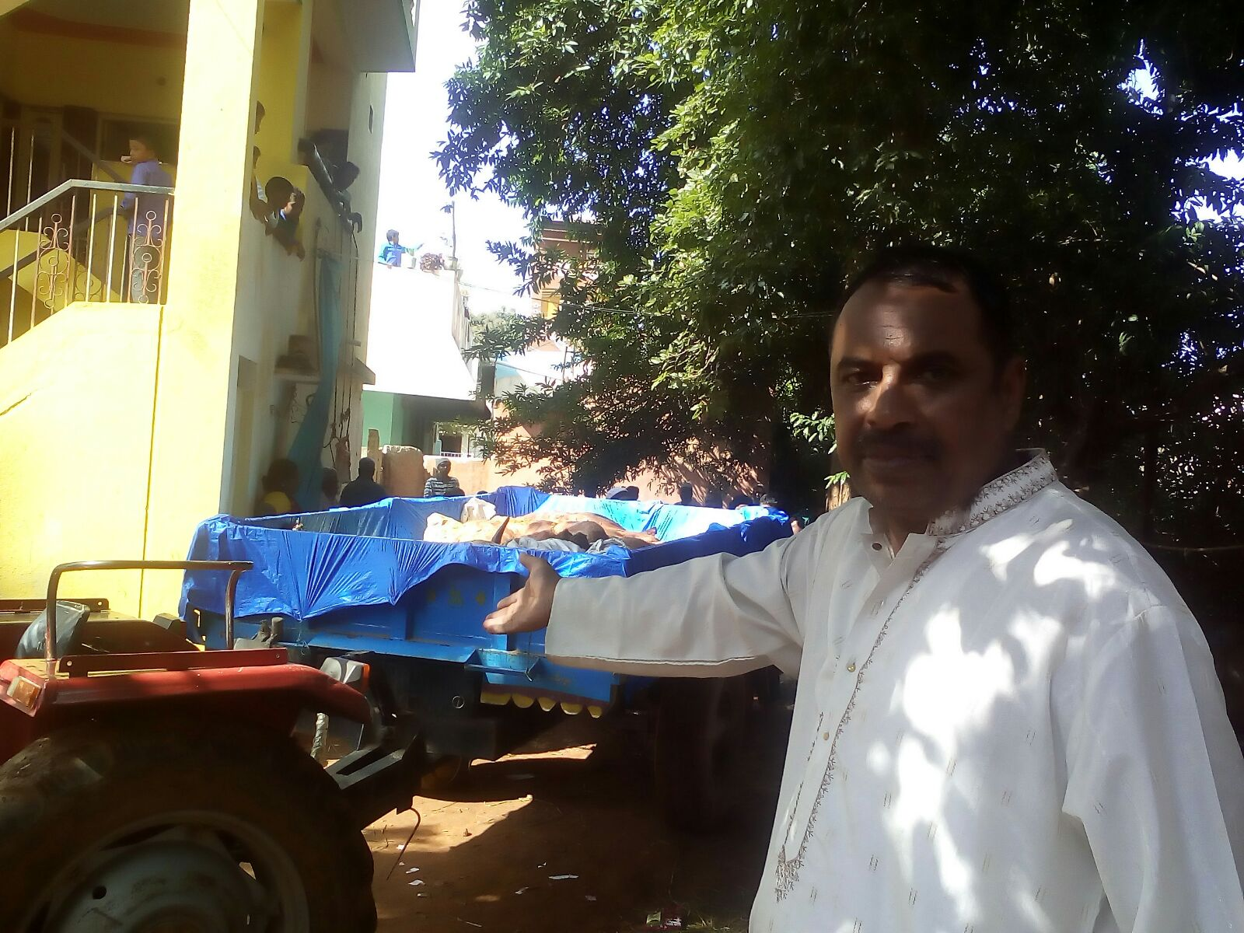
Nearly 80 tons of segregated meat waste was composted the same day.

Slide 13
DASARA FESTIVAL
Each area had its own volunteers who worked with the area BBMP officials and contractors.
Tonnes of biodegradable waste was segregated at the spot, loaded into trucks and sent for composting.
Dry waste was sent to nearby DWCCs.
Overnight, almost all the roads were free from large banana stems, flower and vegetable waste.

Slide 14
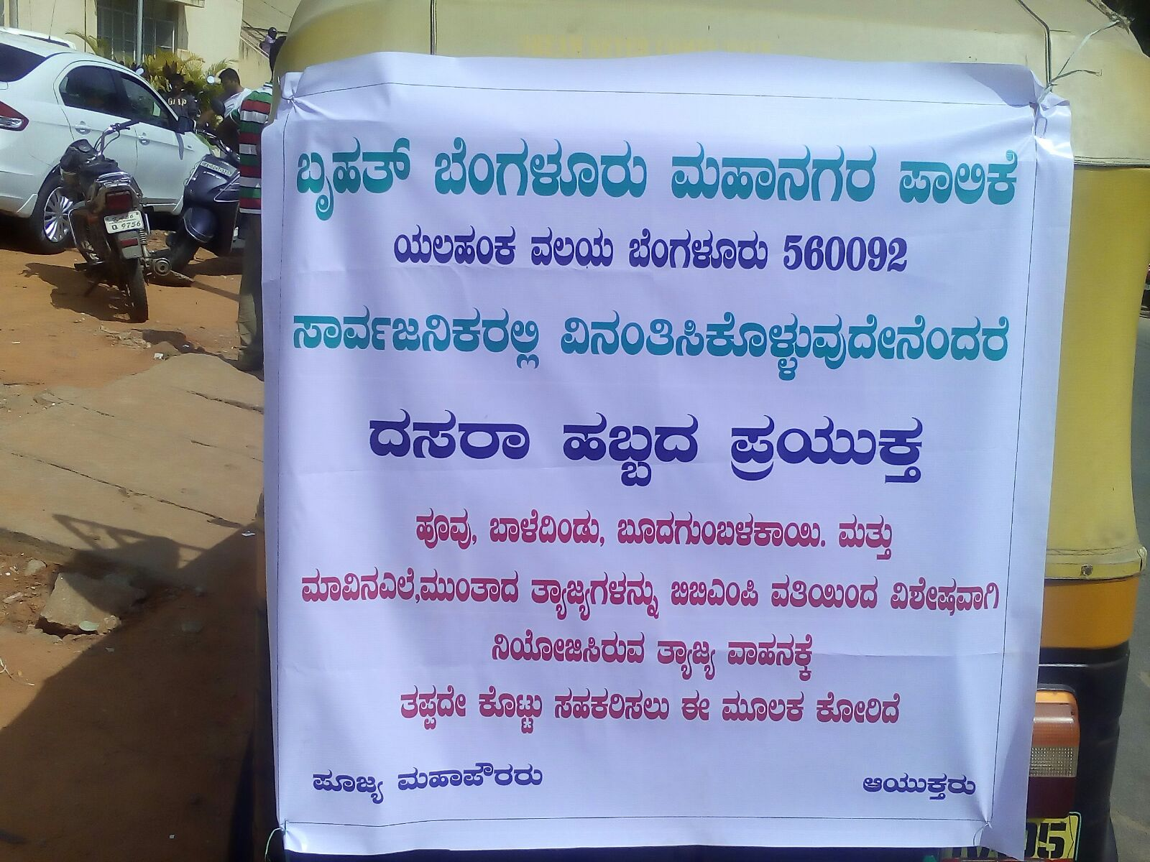

Slide 15
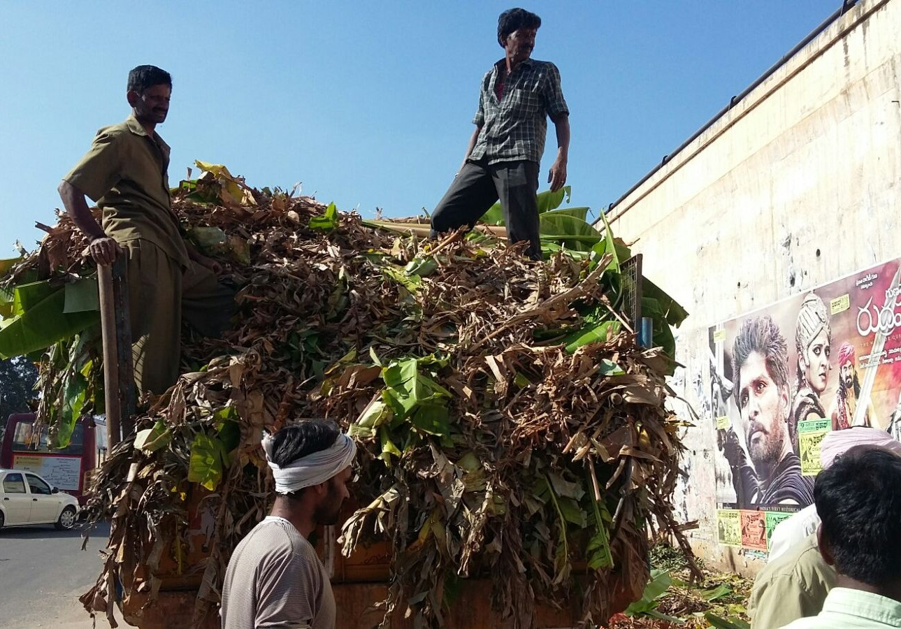

Slide 17
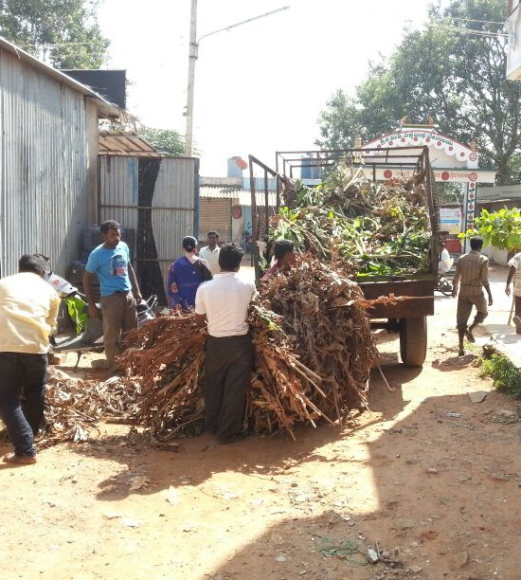
BBMP staff and YEG volunteers worked hard to clear the roadside waste overnight.

Slide 18
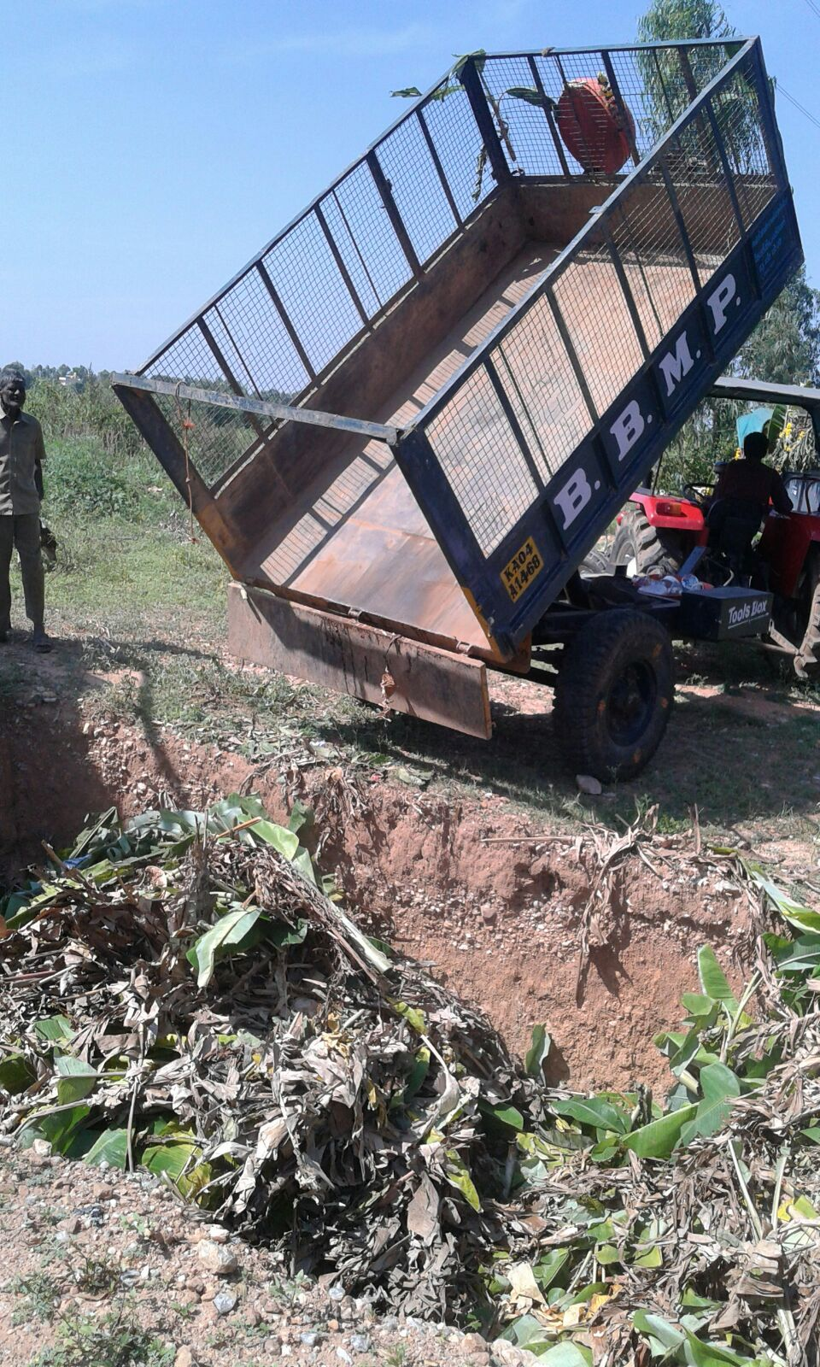
COMPOSTING:
The green waste was offloaded into large pits dug in a farmland.

Slide 19
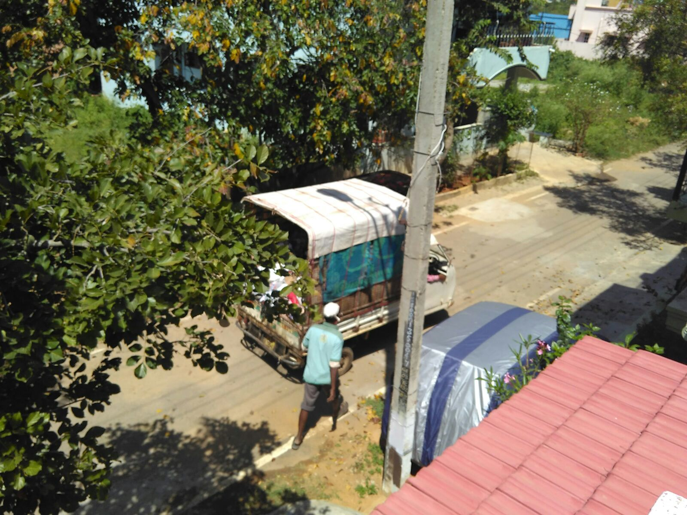
CLEAN ROADS!

Slide 20
DEEPAVALI FESTIVAL
Preparatory meetings held 10 days before the festival to discuss strategies.
A meeting of pourakarmikas stressing the importance of segregation at the spot held.
Many awareness programmes held in schools & localities to create awareness on the hazards of firecrackers.
Many schoolchildren were roped in to drive home the message.
Rains came to the rescue!
Waste was handled in the same manner as was done during Dasara.

Slide 21
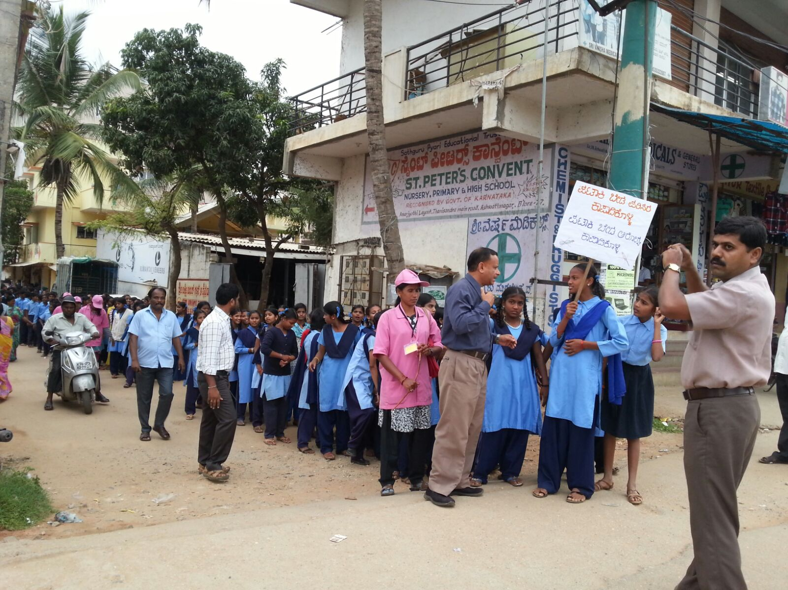

Slide 22
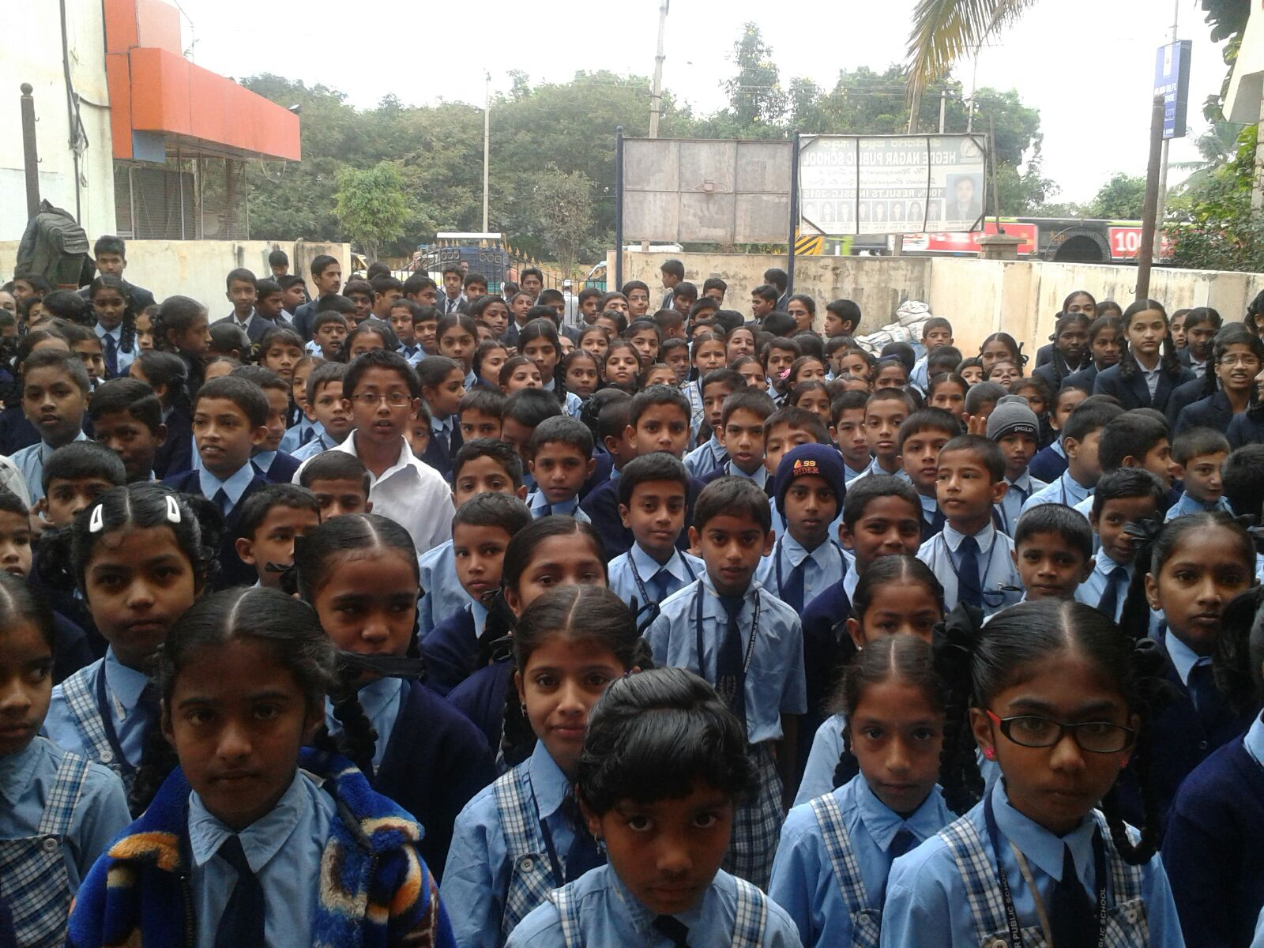

Slide 23
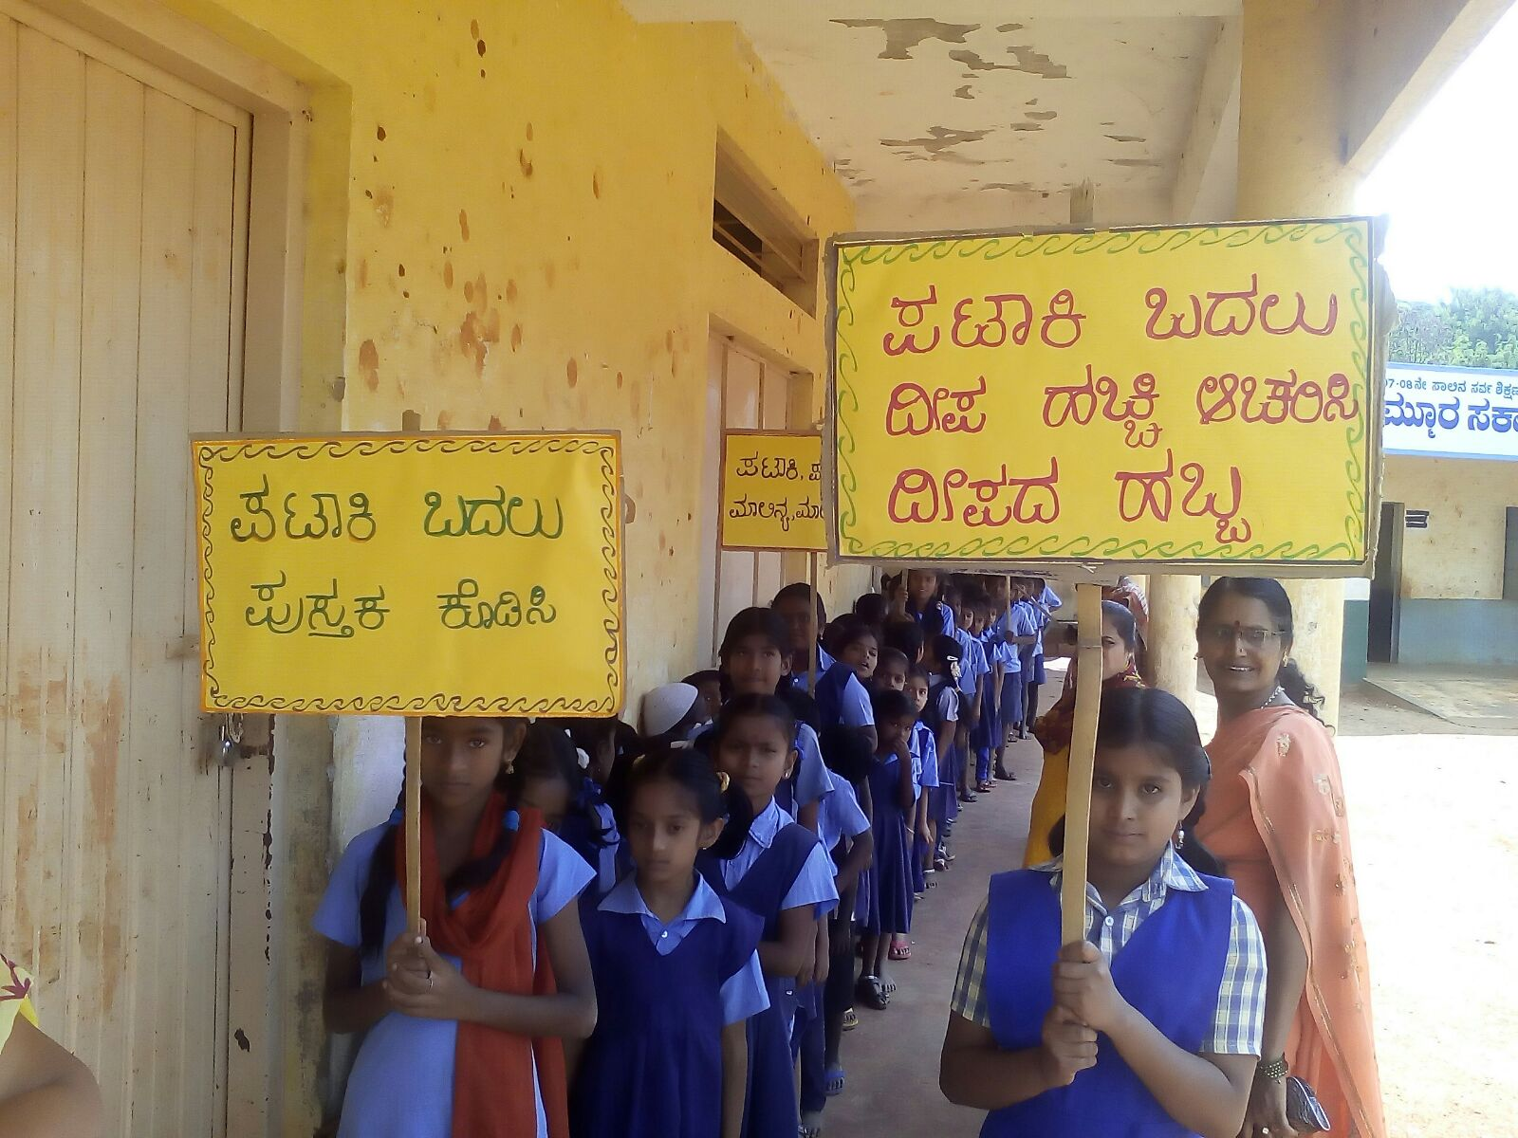

Slide 24
COMPOSTING ON A LARGE-SCALE
A volunteer offered space in her land for composting
Large pits were dug and kept ready before the waste arrived in trucks.
A day after Bakrid, nearly 80 tonnes of meat waste was composted.
Similarly, nearly 60 tonnes of green waste went into the pits just a day after Dasara.
140 TONNES OF GREEN WASTE COMPOSTED.

Slide 25
THE EFFECT
The whole exercise was a co-ordinated teamwork. A shining example of voluntary community engagement, responsibility sharing and understanding of the challenges in every sector from top administrators to the citizens who volunteered.

